Slide 1
The Bechdel Test
Min Jie Kim
Jun Bin Ho
Alison Yao
Fatima Nadeem
Notes:
Good morning, today we’re going to present our project about the Bechdel Test.

Slide 2
Has at least 1 woman
2. Who talk to each other
3. About something other than a man
Invented in 1985, Bechdel Test is simple and popular measure of feminism in films
Notes:
test were first defined back in 1985 in a comic strip featuring two queer women as to simply measure feminism in films
Has at least two women in it,
who talk to each other,
about something other than a man.

Slide 3
Importance of project
Simple and convenient - test too good to be true?
Widely used to measure a film’s social importance, but test itself is not very human centered
Off-screen vs On-screen representation
Notes:
Increased video based media consumption calls for attention towards the unrealistic, stereotypical and limiting themes of the movies. Julia wood divided these themes into 3 parts, firstly that women are under represented, men and women are depicted in stereotypical ways and lastly these depictions normaize violence against women. Bechdel test effectively measures theme 1 but has been heavily criticzed to measure themes 2 and 3. For this reason, we analyze the test to evaluate its human centered shortcomings and how it compares to offscreen metrics

Slide 4
01
1. How are movies performing based on bechdel test, compared to off-screen metrics?
2. What are some prevalent shortcomings of the Bechdel test?
3. what are additional matrics/revisions we can take to better measure feminism in films and filmmaking?
Research Questions
Notes:
Based on critique of Bechdel test, we have designed our project to address the following research questions
How are movies performing based on the Bechdel Test compared to other off-screen metrics, what are its shortcomings and what additional metrics or revisions we can take to better measure feminism in films and filmmaking?

Slide 5
Methods and approach
01
02
Proportion of movies passing bechdel test overtime
Bechdel test vs female/male cast, writers, directors, crew
03
04
Applying our own test
To films
negative/positive contradiction
(films that pass/fail)
Notes:
A quick overview of our approach is that we will quantitatively assess the changes in Bechdel scores over time and how these scores compare with other benchmarks of off screen representation. Building upon this, we qualitatively review the two types of contradictions to the Bechdel scores. The positive contradiction films are the ones that are critiqued as feminist by reviewers but still dont pass bechdel test and the negative contradiction films are the ones that pass bechdel test but have been criticised for negative female representation. Finally we Revise the Bechdel Test with new metrics to address our concerns, as well as bridge the gap between on and off-screen representation.

Slide 6
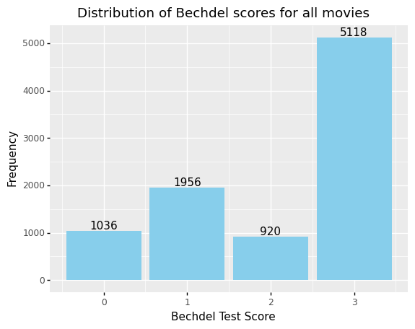
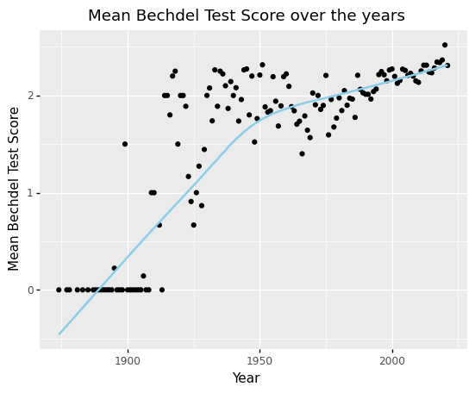
Proportion of movies passing overtime
Data Source: Bechdel Test Movie List
Notes:
For the quantitative analysis, we obtained a dataset with more than 9 thousand movies from the website called “Bechdel Test movie list”, where each movie is manually labeled.
Since movies get one point for meeting each of the 3 criteria, the bechdel score ranges from 0 to 3. 0 means completely failing, while 3 means passing the test. We can see that more than half of the movies in our dataset pass the test. The mean score has also increased over the years, which is great.
However, limitations exit. First, biases. Most movies recorded here are Hollywood movies, which indicates a selection bias in sampling. Also, since people watch movies with the intention to conduct a Bechdel test, they are prone to picking the ones that pass the test, so a passing rate this high might be inflated. Second, some scores are marked Dubious, which means that the scores might change in the future. Therefore, apart from 0 to 3, we added dubious as a new category.
Now, let’s see how the proportion of each category changed over the years.

Slide 7
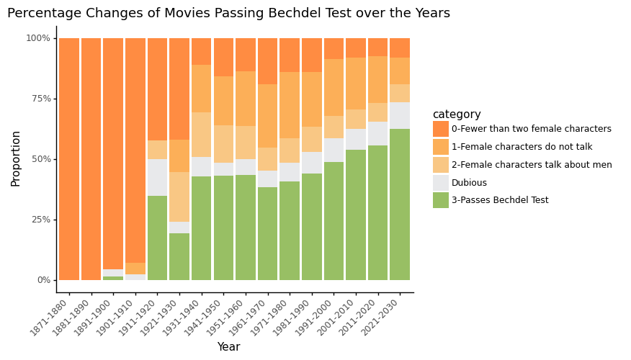
Proportion of movies passing overtime
Low growth rate of films passing: test still relevant!
Majority of films still passing the bare minimum, but the test needs revision to further raise the standard
Data Source: Bechdel Test Movie List
Notes:
From this animated pie chart, we can see that in the beginning, everything is in orange, so no movie passed the test at all. Now, you can see some green color popping up, and the green proportion is increasing over the years, meaning more movies than before are passing the Test. The yearly changes are quite unstable, so we used 10 years as an interval to better illustrate the trend.
While the green proportion is increasing, the orange color is getting lighter, which means that although many movies do not pass, they are getting a higher score, instead of a 0. So, overall, things are getting better.
However, the growth rate in recent years is quite low. Assuming this growth rate of 0.41% per year is maintained, we still need about 90 years to reach a 100% pass rate. So even though the bechdel test is still relevant, it is a minimum standard that needs revision.

Slide 8
Proportion of movies passing bechdel test overtime
Low growth rate of films passing: test still relevant!
Majority of films still passing today: test needs revision

Slide 9
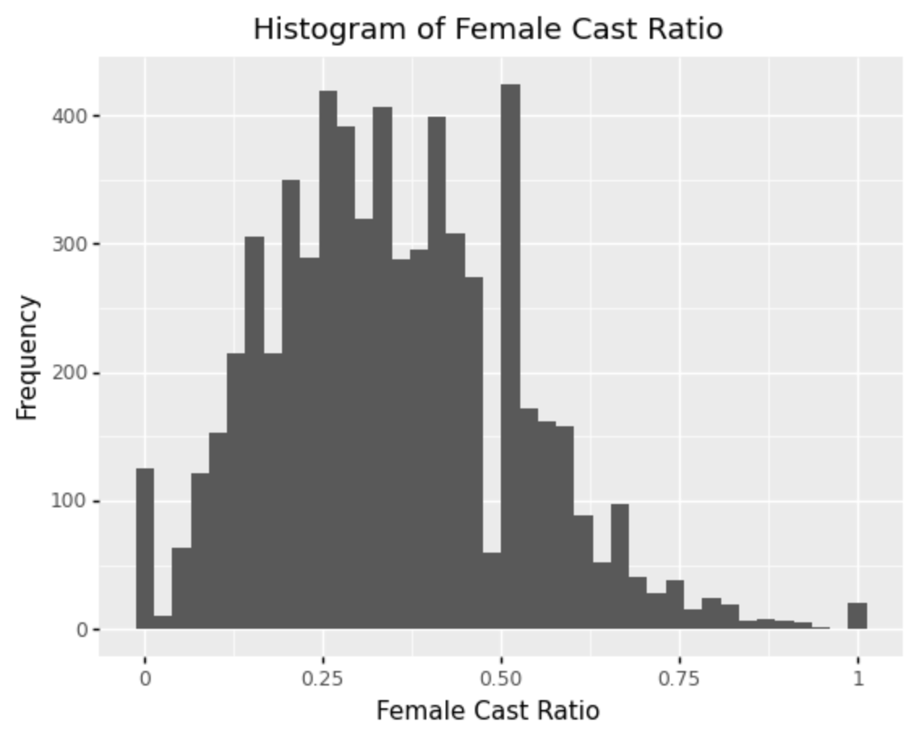
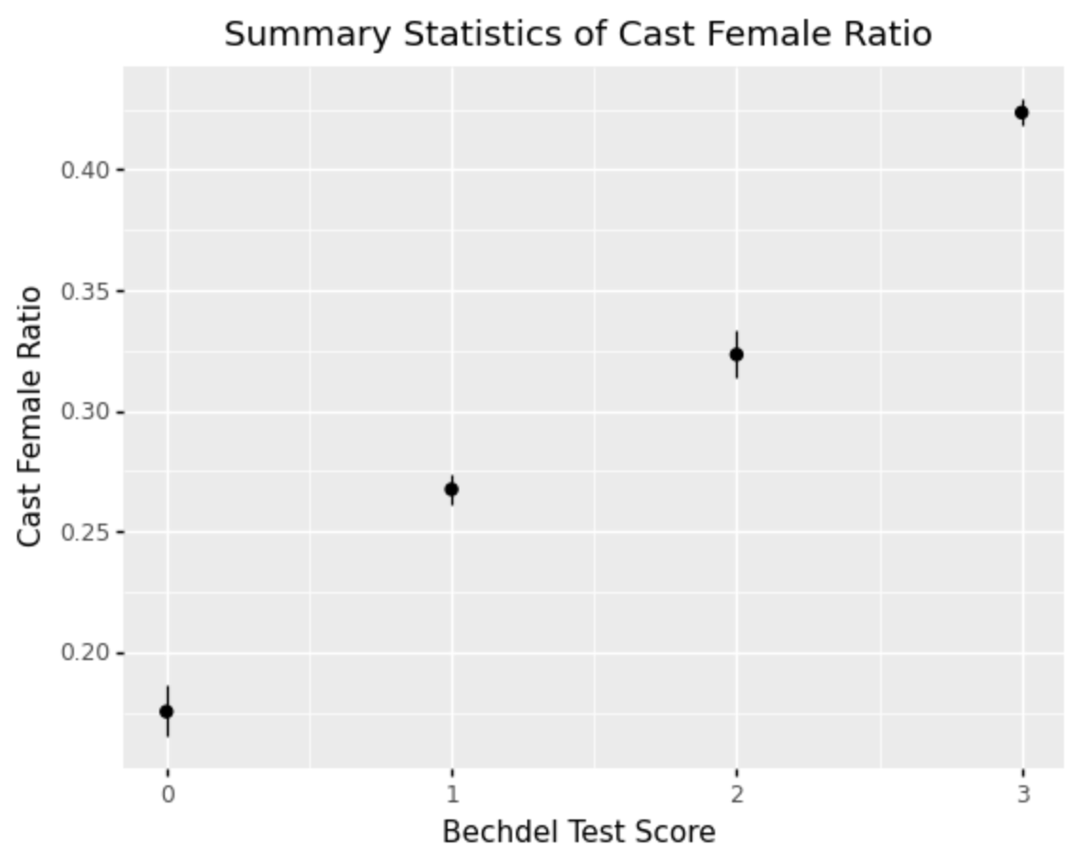
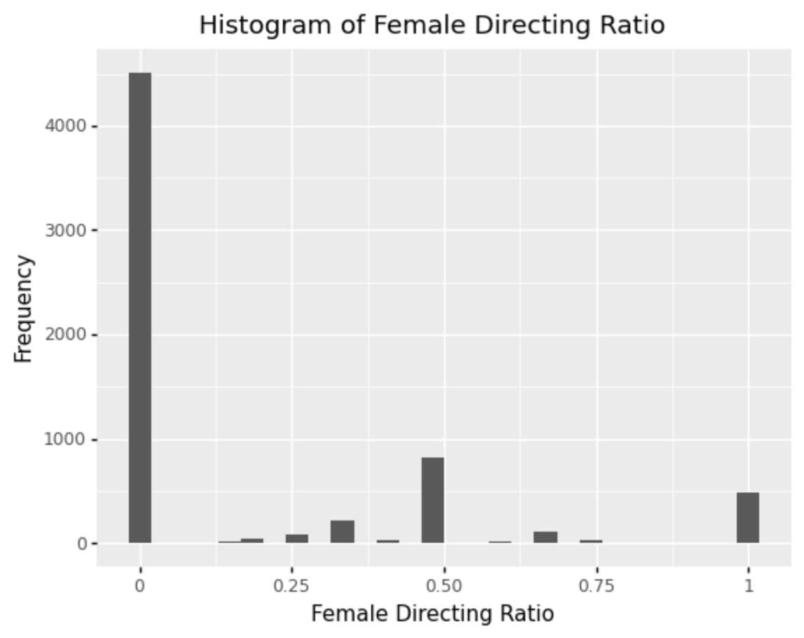
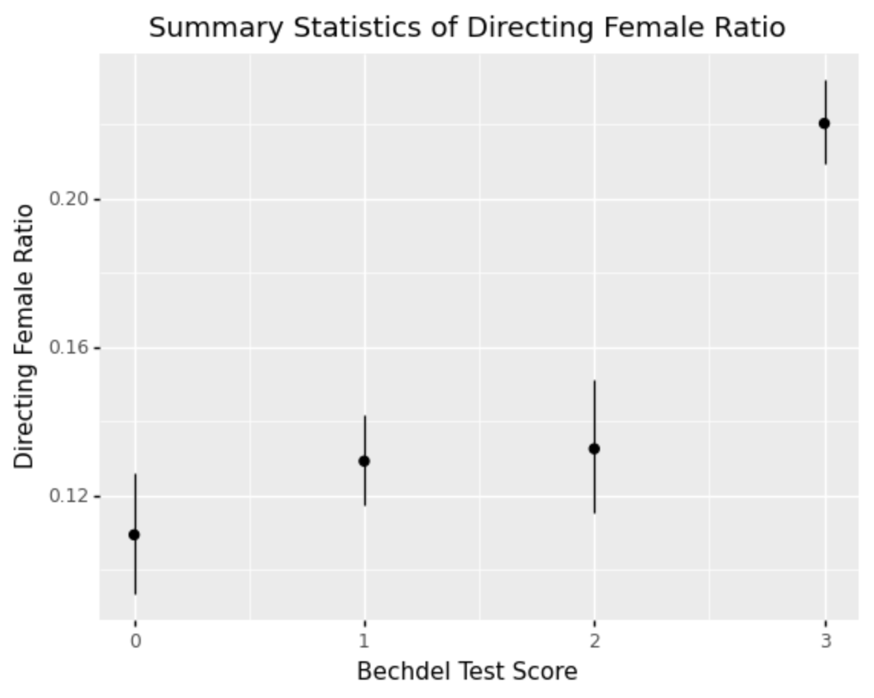
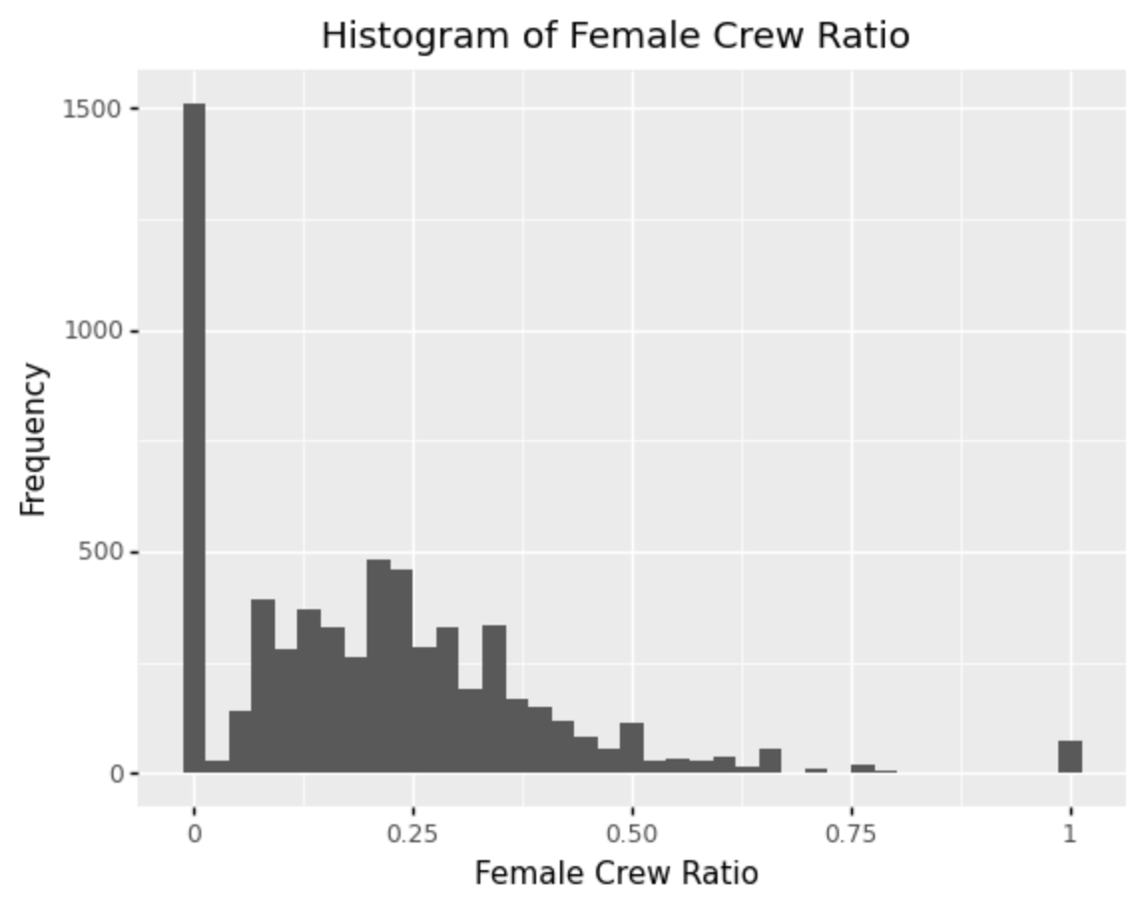
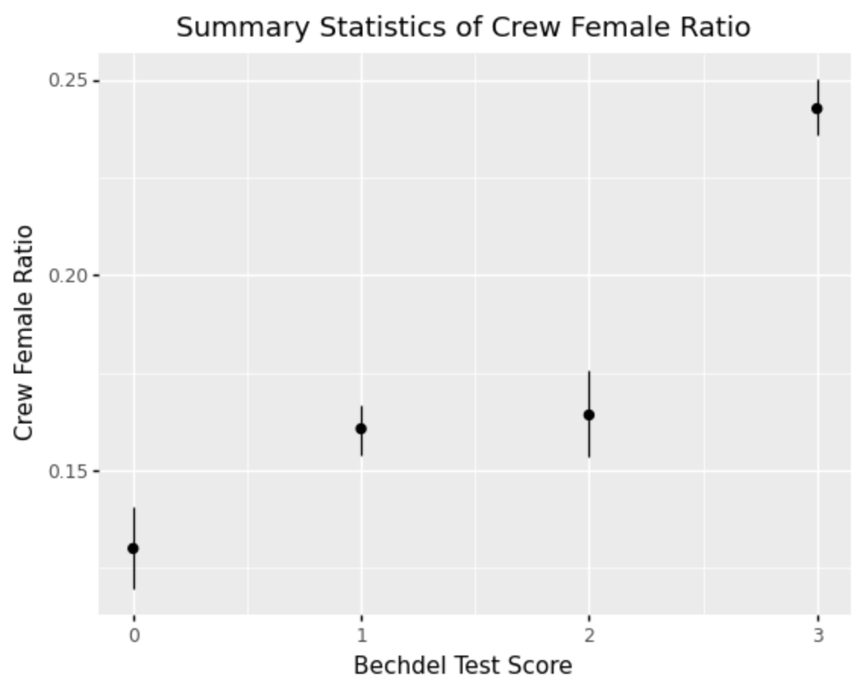
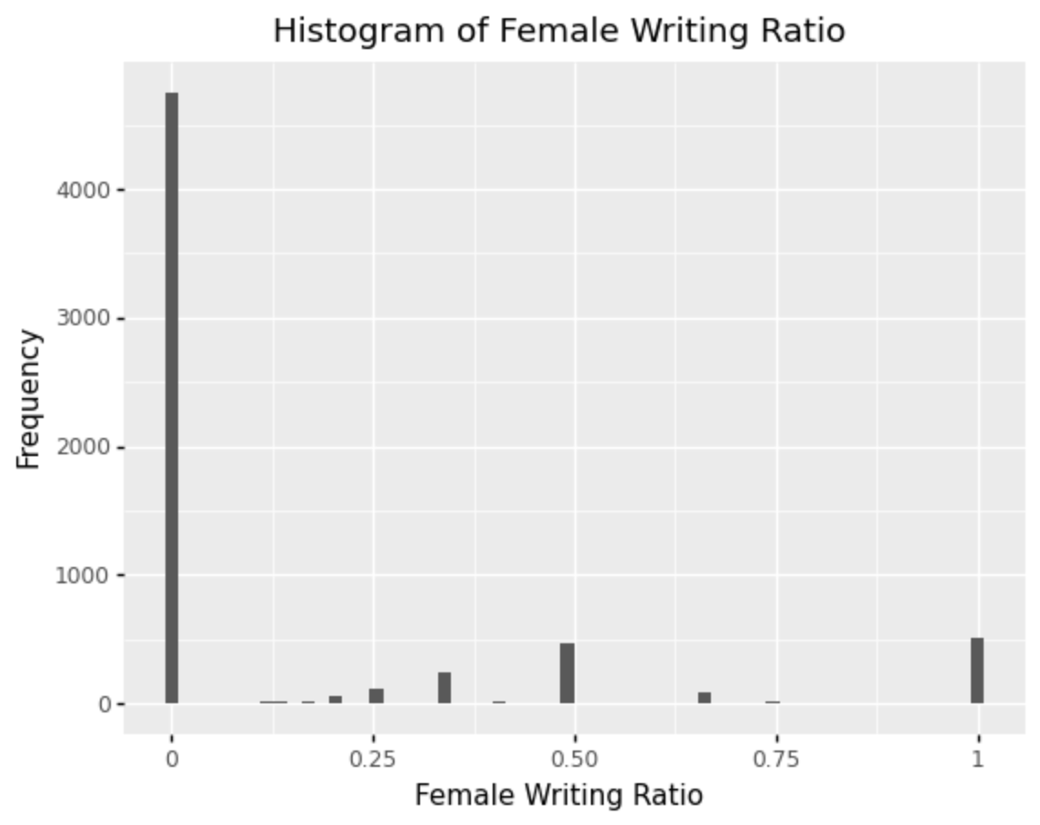
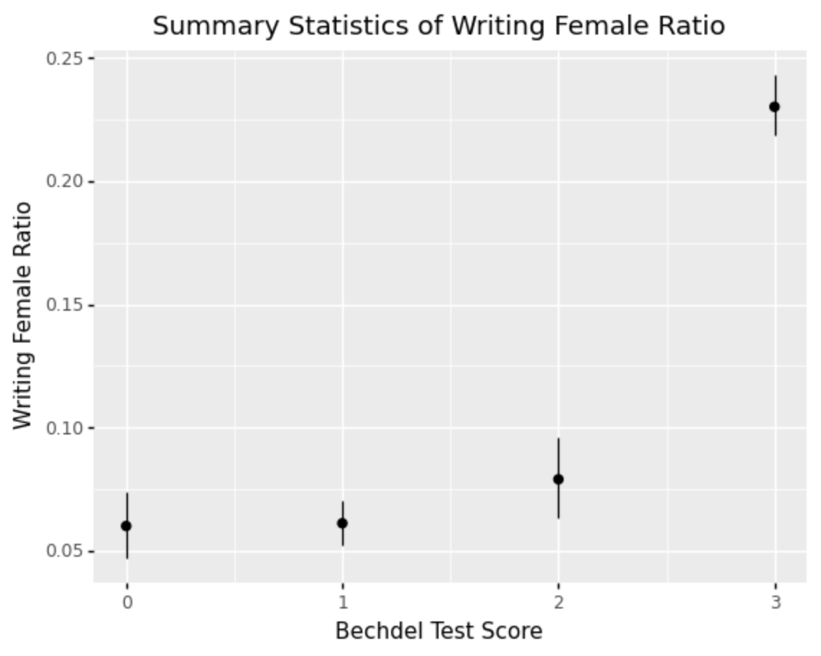
Bechdel test vs Off-screen matrics
Data Source: Kaggle
Notes:
After analyzing the bechdel test data, we joined it with another dataset on Kaggle to compare the bechdel scores with female ratios in cast, crew, writing and directing departments. Bechdel test focuses on the on-screen representation, while the female ratios are off-screen matrics, so putting them side-by-side bridges the gap.
The histograms show that although most movies have a lot of female cast members, many do not have female crew or directors, or writers at all. For the summary statistics, we can see that the groups failing the Bechdel test overlap and are not always different from each other, but they all have a lower female ratio compared to movies passing the test.
The statistics shows a visible positive correlation. The more female members there are in the cast and crew, the more likely it is to pass the Bechdel Test. But the female ratios for passing movies are surprisingly low—below around 25% for all, except for cast.

Slide 10

Bechdel test vs female/male cast, writers, directors, crew
Below 25% for female writers, directors, crew with films passing Bechdel Test
Importance of off-screen representation, which Bechdel Test fails to cover
Notes:
Therefore, we conclude that the Bechdel Test does reflect the off-screen representation to some extent, but it is still important to include off-screen metrics for future analysis, especially as the concept of feminism evolves.
Next, we will examine the Bechdel Test through qualitative analysis.

Slide 11


contradictioNs
JURASSIC WORLD (P)
THE AVENGERS (F)
Notes:
We’ve taken an ethnographic approach approach on top of our qualitative analysis to identify limitations of the Bechdel Test. Looking at user posts on the Bechdel Test review site, we have found many examples of contradictions in the Bechdel Test, that is, films that surprisingly pass or fail the test.
Taking these examples, we suggest two issue-specific tests that address specific problems in female representation. For the sake of time, we’ll only share one example here.
From the case of Jurassic World, we see a movie that passed, but that has been criticized for its representation of women. In the film, Claire, the female operations manager of Jurassic World loses control of park when a dangerous species escapes its enclosure. While Claire was a successful professional, she was portrayed as incompetent when the situation deteriorated, and she had to depend on a male protagonist to save her. On the rating site, user Sophie writes about the failure:

Slide 12
“The message that I got from it was that this was not really important because she had perfect hair, skin, and make-up and was hot and was probably earning a really good salary and that is success for a woman, right? Then her relationship with the dinosaur trainer was also appallingly sexist. When [things] hit the fan and the reckless behaviour of the company is exposed, she needs a man to save her.
Notes:
“The message that I got from it was that this was not really important because she had perfect hair, skin, and make-up and was hot and was probably earning a really good salary and that is success for a woman, right? Then her relationship with the dinosaur trainer was also appallingly sexist. When [it] hits the fan and the reckless behaviour of the company is exposed (i.e., monster dinosaur escapes its cage), she needs a man to save her.
The fact that a strong female character had a challenging occupation in itself was insufficient, as representation is relational. How is the woman represented in relation to the man? Did the woman need a man to save her? With these criticisms of Jurassic park, we see that the Bechdel Test fails to account for factors that multiple human users were easily able to spot. Despite easily passing the Bechdel Test, Jurassic World’s portrayal of Claire strongly overshadows the Bechdel Test’s signal that the film is a feminist film.

Slide 13
For movies with characters that have any technical or professional occupation:
Women are not represented among the professionals in the film—0
There is at least one woman with a technical or professional career—1
The woman solves, or is integral to solving, a technically complex problem—2
The woman solves a technically complex problem independent or despite of a man—3
Notes:
Together with an analysis of the movie gravity, we’ve come up with the above test.
A movie only pass our professional representation test if it has a female character solves a technically complex problem independent or despite of a man.

Slide 14
contradictioNs
JURASSIC WORLD (P)
THE AVENGERS (F)
Notes:
Now we will apply our Test to Avengers
The Avengers movie failed the Bechdel Test, but featured prominent and strong female characters—the Black Widow, Pepper Potts, and Agent Maria Hill
The Black Widow was the only female member of the Avengers, but her strength and expertise as a spy for S.H.I.E.L.D were showcased in her first scene where she was tasked to take down a weapons trafficking general. The scene showcases her combat ability and skilful diversion as a spy as she subdues three men alone while being chained to a chair.
From the first scene alone, the film would pass the final criteria of our test, which requires that a “woman solves a technically complex problem independent of or despite of a man”. This gives the film credit for positive professional female representation.
MJ) However, according to the third wave of feminism, feminism should be inclusive to all women, including of all races. However, the women represented in Avergers the black widow, pepper, Agent Hill, are all caucassian. Therefore, the movie does not pass the current feminist definition despite passing our test.

Slide 15
Summary of Findings, Implications and Limitations
Is the Bechdel Test still useful? Yes, but we should not stop there.
More Tests are needed
Limitations of Our Tests:
Issue-specific tests are hard to scale
More nuanced tests like the ones we’ve suggested are more disputable
Many data points in off-screen representation are difficult to obtain
Notes:
Is the Bechdel Test still useful? Yes, but we should not stop there. Since the Bechdel Test’s creation in 1985, the pass rate has increased by an average of 0.41% per year. Assuming this growth rate is maintained, we would only reach a 100% pass rate in 2110.
However, more than half of the films in our dataset now pass the Bechdel Test. This calls for other benchmarks that further disentangle representation among the tests that have passed, including off-screen benchmarks, which still reflect severe underrepresentation of women in non-cast roles, as well as other tests for on-screen representation.
The tests we suggest are far less universal than the Bechdel Test because they are issue-specific. This is where human-centeredness is key—we cannot identify all the problems with female representation with just a single, universal Bechdel Test. Tests informed by empirical film analysis are key to flagging harmful stereotypes in films.
A key problem with this is scalability, as a greater number of issue-specific tests with nuanced criterion means greater difficulty in application. The straightforward Bechdel Test has yet to be applied onto every movie by a reviewer; increasing the number of tests will only grow the scope of assessment further.
Furthermore, the higher standards in tests might also be disputed, as there is no single authority on how women should be represented on film. Nuanced conditions can also be more difficult to apply, with viewers often disagreeing on even the simple Bechdel test. The language we use in our tests (e.g. “Technically complex problem”) can mean different things to different viewers.
Beyond on-screen representation, many data points in off-screen representation are also difficult to obtain. Consider sexual orientation—this is not something usually reported, and we might not be able to obtain datapoints on queer women or transgender women.

Slide 16
Thank you

